Slide 1
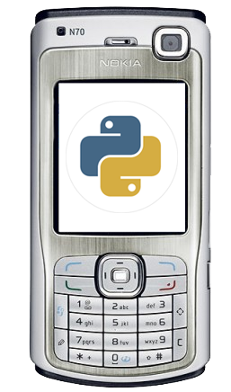

Intro to J2ME
Taken from Vidya Setlur’s Course on Java
DAY 2 -- UI for J2ME
Nathan Eagle, PhD
Research Scientist
MIT Design Laboratory
Massachusetts Institute of Technology
April 2007
GSTIT, Addis Ababa, Ethiopia

Slide 2
MIDP UI Packages
MIDP 2.0 provides UI classes in two packages: javax.microedition.lcdui and javax.microedition.lcdui.game
lcdui stands for liquid crystal display user interface (LCD UI).
The UI classes of of MIDP 2.0's javax.microedition.lcdui package are divided into two logical groups: the high-level and low-level groups.

Slide 3
High-level UI Components
More or less ‘display agnostic’ as the classes are heavily abstracted concerning look-and-feel.
It is up to the device to manage how these UI components are displayed.
Such MIDlets can target a large number of devices, because these classes do not provide exact control over their display.
Screen
Alert
Form
List
TextBox

Slide 4
Low-level UI Components
The classes of the low-level group require precise control over their location and display on the device.
MIDlets are less portable and may not be deployable on certain devices, because they require precise control over the way they look and feel.
Canvas
Graphics
Notes:
Another low-level UI component GameCanvas will be discussed when we talk about the game API.

Slide 5
Displaying a UI Component
Low and high level components must implement the Displayable interface. A displayable class may have a title, a ticker, and other commands associated with it.
Screen and Canvas classes and their subclasses implement this interface.
Note: The Graphics class does not implement this interface as it uses low-level 2D graphics to help display on the device's screen.

Slide 6
Class Displayable
A Displayable class is a UI element that can be shown on the device's screen while the Display class abstracts the display functions of an actual device's screen and makes them available to you.
A MIDlet can show a Displayable UI element on a Display using the setCurrent(Displayable element) method of the Display class.
Display can have only one Displayable element at one time, which becomes the current element on display. The current element that is being displayed can be accessed using the method getCurrent(), which returns an instance of a Displayable element.
The static method getDisplay(MIDlet midlet) returns the current display instance associated with your MIDlet method.

Slide 7
Alert
Alerts are best used in informational or error messages that stay on the screen for a short period of time and then disappear. You can control several aspects of an alert by calling the relevant methods or using the right constructor.
The title must be set while creating the alert and it cannot be changed afterwards: Alert(“Alert!");.
To set the message the alert displays use, setString(“print message").
setTimeout(int time) is used to set the time (in milliseconds) for which the alert is displayed on the screen. If you pass Alert.FOREVER as the value of time, you will show the alert forever and make the alert a modal dialog.
There are five types of alerts defined by the class AlertType: ALARM, CONFIRMATION, ERROR, INFO, and WARNING. These have different looks and feels and can have a sound played along with the alert.
You can associate an image with the alert using the method setImage(Image img);.
You can set an indicator with the alert using setIndicator(Gauge gauge); method.

Slide 8
import javax.microedition.midlet.*;
import javax.microedition.lcdui.Alert;
import javax.microedition.lcdui.Display;
public class printerMidlet extends MIDlet {
Alert printAlert;
public printerMidlet() {
printAlert = new Alert("Alert!");
printAlert.setString(“print message”);
}
public void startApp() {
Display.getDisplay(this).setCurrent(printAlert);
}
public void pauseApp() {}
public void destroyApp(boolean unconditional) {
}
}
Notes:
A Displayable UI element, an Alert, is created in the constructor. When the device's Application Management Software (AMS) calls the startApp() method, the current display available for this MIDlet is extracted using the Display.getDisplay() method. The Alert is then made the current item on display, by setting it as a parameter to the setCurrent() method.

Slide 9
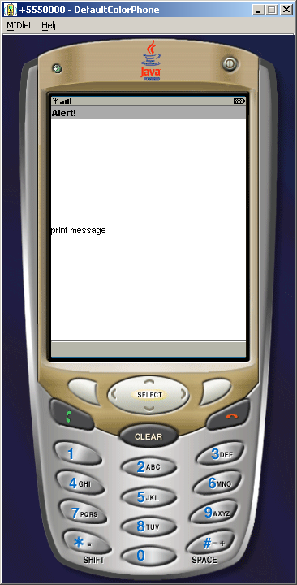

Slide 10
List
A list contains one or more choices, where each choice must have a text part, an optional image part, and an optional font for the text part.
The List element implements the Choice interface, which defines the basic operations of this element. The list must itself have a title, and must define a policy for the selection of its elements. This policy dictates whether only one element can be selected (Choice.EXCLUSIVE), multiple elements can be selected (Choice.MULTIPLE), or the currently highlighted element is selected (Choice.IMPLICIT).
You can create a list in one of two ways.
Create an list that contains no elements, and then append or insert individual elements.
OR
Create the elements beforehand and then create a list with these elements.

Slide 11
import javax.microedition.midlet.*;
import javax.microedition.lcdui.Display;
import javax.microedition.lcdui.List;
import javax.microedition.lcdui.Choice;
public class printerMidlet extends MIDlet {
List printList1;
List printList2;
public printerMidlet() {
printList1 = new List("Select a movie you like",
Choice.MULTIPLE);
printList1.append(“Matrix", null);
printList1.append(“Crash", null);
printList1.append(“Incredibles", null);
String movies[] = {"Godfather", “Memento", “Vertigo"};
printList2 = new List( "Select a movie you like - List 2", Choice.IMPLICIT, movies, null);
}

Slide 12
public void startApp() {
Display display = Display.getDisplay(this);
display.setCurrent(printList1);
try {
Thread.currentThread().sleep(10000);
}
catch(Exception e) {}
display.setCurrent(printList2);
}
public void pauseApp() {}
public void destroyApp(boolean unconditional) {}
}

Slide 13
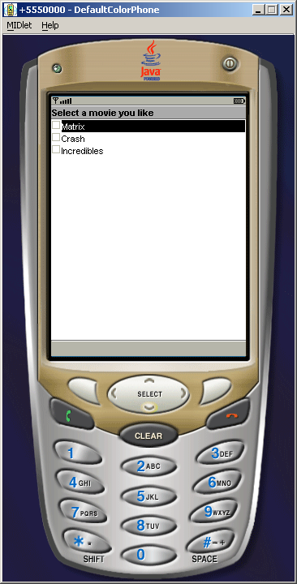
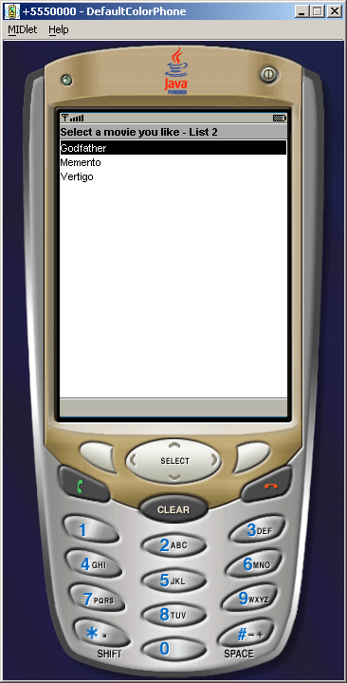

Slide 14
TextBox
Text is entered in a textbox.
You can restrict the maximum number of characters that a user is allowed to enter into a textbox, but you need to be aware of the fact that the implementation of this value depends upon the device that you are running it on.
There are six constraint settings: ANY, EMAILADDR, NUMERIC, PHONENUMBER, URL, and DECIMAL. ANY allows all kinds of text to be entered.
Similarly, there are six constraint settings that affect the display: PASSWORD, UNEDITABLE, SENSITIVE, NON_PREDICTIVE, INITIAL_CAPS_WORD, and INITIAL_CAPS_SENTENCE. Not all of these settings may be functional in all devices.
For example, to only accept email addresses in a textbox, you will need to set the TextField.EMAILADDR flag using the method setConstraints(). To make this field uneditable, you will need to combine it with the TextField.UNEDITABLE flag. This is done by doing a bitwise OR operation between these two flags: setConstraints(TextField.EMAILADDR | TextField.UNEDITABLE);.

Slide 15
import javax.microedition.midlet.MIDlet;
import javax.microedition.lcdui.TextBox;
import javax.microedition.lcdui.TextField;
import javax.microedition.lcdui.Display;
public class printerMidlet extends MIDlet {
private TextBox textBox;
public printerMidlet() {
textBox = new TextBox( "Your First Name?", "", 60,
TextField.ANY);
}
public void startApp() {
Display.getDisplay(this).setCurrent(textBox);
}
public void pauseApp() {}
public void destroyApp(boolean unconditional) {
}
}

Slide 16
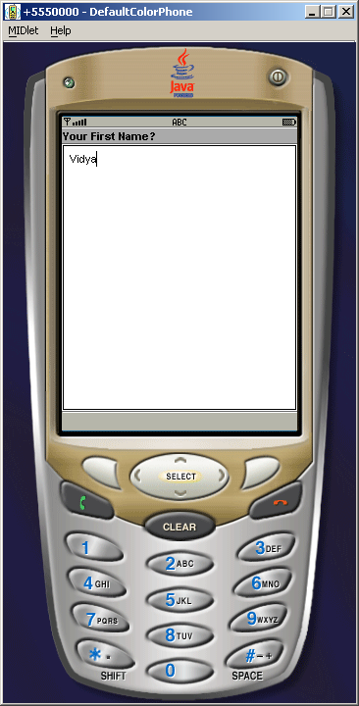

Slide 17
In Class Exercise
Modify the textbox MIDlet so that after you enter your first name, it appends your last name to your first name after a small delay.

Slide 18
Form
A form is a collections of instances of the Item interface. The TextBox class is a standalone UI element, while the TextField is an Item instance. Essentially, a textbox can be shown on a device screen without the need for a form, but a text field requires a form.
An item is added to a form using the append(Item item) method. The first added item is at index 0, the second at index 1, and so on. insert(int index, Item newItem) method inserts an item at a particular position. set(int index, Item newItem) replaces an item at a particular position specified by the index.
There are eight Item types that can be added to a form.
StringItem: A label that cannot be modified by the user. This item may contain a title and text, both of which may be null to allow it to act as a placeholder. The Form class provides a shortcut for adding a StringItem, without a title: append(String text)
DateField: Allows the user to enter date/time in one of three formats: DATE, TIME, or DATE_TIME.
TextField: Same as a TextBox.
ChoiceGroup: Same as a List.
Spacer: Used for positioning UI elements by putting some space between them. This element is an invisible UI element and can be set to a particular size.
Gauge: A gauge is used to simulate a progress bar.
ImageItem: An item that holds an image. Like the StringItem, the Form class provides a shortcut method for adding an image: append(Image image). Put images in the res folder.
CustomItem: CustomItem is an abstract class that allows the creation of subclasses that have their own appearances, their own interactivity, and their own notification mechanisms. If you require a UI element that is different from the supplied elements, you can subclass CustomItem to create it for addition to a form.

Slide 19
import javax.microedition.midlet.*;
import javax.microedition.lcdui.Display;
import javax.microedition.lcdui.Form;
import javax.microedition.lcdui.Gauge;
import javax.microedition.lcdui.Spacer;
import javax.microedition.lcdui.ImageItem;
import javax.microedition.lcdui.TextField;
import javax.microedition.lcdui.DateField;
import javax.microedition.lcdui.StringItem;
import javax.microedition.lcdui.ChoiceGroup;
import javax.microedition.lcdui.Image;
import javax.microedition.lcdui.Choice;
public class printerMidlet extends MIDlet {
private Form form;
private Gauge gauge;
private Spacer spacer;
private ImageItem imageItem;
private TextField txtField;

Slide 20
private DateField dateField;
private StringItem stringItem;
private ChoiceGroup choiceGroup;
public printerMidlet() {
form = new Form("Your Booking Details");
// a StringItem is not editable
stringItem = new StringItem("Your Id: ", “123456");
form.append(stringItem);
// you can accept Date, Time or DateTime formats
dateField = new DateField("Your Date of Arrival: ",
DateField.DATE);
form.append(dateField);
// similar to using a TextBox
txtField = new TextField( "Your Name: ", "", 60, TextField.ANY);
form.append(txtField);
// similar to using a List
choiceGroup = new ChoiceGroup( “Room: ", Choice.EXCLUSIVE, new String[] {“Smoking", "Non-smoking"}, null);
form.append(choiceGroup);

Slide 21
// put some space between the items to segregate
spacer = new Spacer(20, 20);
form.append(spacer);
// a gauge is used to show progress
gauge = new Gauge("Step 1 of 3", false, 3, 1);
form.append(gauge);
// an image may not be found
try {
imageItem = new ImageItem( “Copyrighted by: ", Image.createImage("/copyright.png"),ImageItem.LAYOUT_DEFAULT, “copyright");
form.append(imageItem);
}
catch(Exception e) {}
}
public void startApp() {
Display.getDisplay(this).setCurrent(form);
}
public void pauseApp() {}
public void destroyApp(boolean unconditional) {
}
}

Slide 22
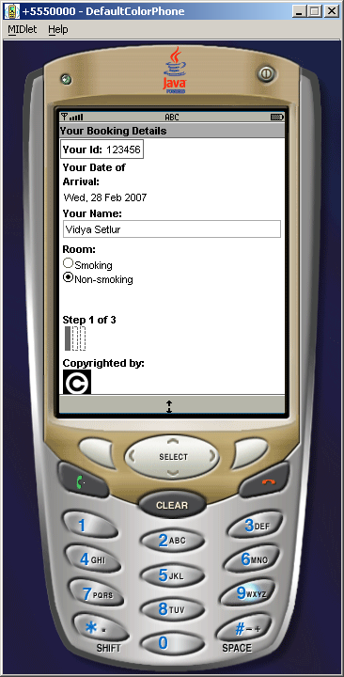

Slide 23
Tickers
A ticker can be attached to any UI element that extends the Displayable abstract class, and displays a running piece of text across the screen whenever the element that is attached to it is shown on the screen.
Since the ticker can be used with all displayable elements, it provides a handy way to display information about the current element on the screen.
The Displayable class provides the method setTicker(Ticker ticker), and the ticker can itself be created using its constructor Ticker(String str), with the message that you want the ticker to display.

Slide 24
Gauges
Gauges are UI instances can be represented in non-interactive and interactive mode.
A gauge in a non-interactive mode typically can be used to represent the progress of a certain task; for example, when the device may be trying to make a network connection or reading a datastore, or when the user is filling out a form.
Non-interactive gauges take four values:
The label -> String
Whether it is interactive mode -> true | false
Maximum value
Initial value
If you don’t know how long a particular activity is going to take, you can use the value of INDEFINITE for the maximum value. Note: You cannot create an interactive gauge with an INDEFINITE maximum value.
This type of gauge can be in one of four states, and this is reflected by the initial value These states are CONTINUOUS_IDLE, INCREMENTAL_IDLE, CONTINUOUS_RUNNING, and INCREMENTAL_UPDATING.

Slide 25
Gauges
import javax.microedition.midlet.*;
import javax.microedition.lcdui.Form;
import javax.microedition.lcdui.Gauge;
import javax.microedition.lcdui.Display;
public class printerMidlet extends MIDlet {
private Form form;
private Gauge gauge;
public printerMidlet() {
form = new Form("Gauge Demo");
gauge = new Gauge( “Interactive", true, 3,0); form.append(gauge);
}
public void startApp() {
Display.getDisplay(this).setCurrent(form);
}
public void pauseApp() {}
public void destroyApp(boolean unconditional) {
}
}

Slide 26
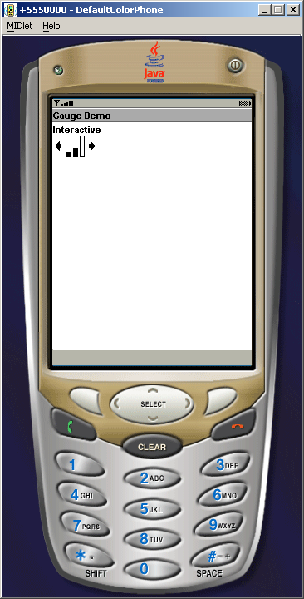
Gauges

Slide 27
In Class Exercise
Modify the previous example and try out different values for non-interactive gauges.

Slide 28
Images
You can associate an image with an Alert and a Choice-based UI element.
An image that is created in-memory, by using the createImage(int width, int height) method, is mutable. An image created this way initially has all of its pixels set to white, and you can acquire a graphics object on this image by using the method getGraphics() to modify the way it is rendered on screen.
To acquire an immutable image, you can use one either: createImage(String imageName) or createImage(InputStream stream).
To create an immutable image from in-memory data, you can either use createImage(byte[] imageData, int imageOffset, int imageLength) or createImage(Image source). The first method allows you to form an image out of a byte array representation, while the second allows the creation of an image from an existing image.
Portable Network Graphic (PNG) format is the mandated format.
Make sure that whenever you reference images in your MIDlets that the images are kept in the right location. E.g., if you want to keep all of your images for a MIDlet in an image folder in the final packaged .jar file, and not the top-level .jar folder, you will need to keep these images under res/image folder. To reference any of these images, you will need to ensure that you reference them via this images folder.

Slide 29
User Interaction
A MIDlet interacts with a user through commands and can only be associated with a displayable UI element. Like a ticker, the Displayable class allows the user to attach a command to it by using the method addCommand(Command command). Unlike a ticker, a displayable UI element can have multiple commands associated with it.
The Command class holds the information about a command. This information is encapsulated in four properties: a short label, an optional long label, a command type, and a priority.
Command exitCommand = new Command("EXIT", Command.EXIT, 1);
Commands are immutable once created.
By specifying the type of a command, you can map any predefined keys on the device to the command itself. For example, a command with the type OK will be mapped to the device's OK key. Others are BACK, CANCEL, EXIT, HELP, ITEM, SCREEN, and STOP. The SCREEN type relates to an application-defined command for the current screen. Both SCREEN and ITEM usually never have any device-mapped keys.
By specifying a priority, you tell the AMS running the MIDlet where and how to show the command. A lower value for the priority is of higher importance, and therefore indicates a command that the user should be able to invoke directly. For example, you would probably always have an exit command visible to the user and give it a priority of 1. Since the screen space is limited, the device then bundles less-important commands into a menu.
In order to provide interaction, the command is associated with a listener using the method setCommandListener(CommandListener listener) from the Displayable class.
The responsibility for acting on commands is performed by a class implementing the CommandListener interface via the method: commandAction(Command cmd, Displayable display).

Slide 30
In Class Exercise
Modify the Form MIDlet example by adding some commands to the form such as mapping destroyApp to the exit key, etc.
Hint:
First make sure your main class implements CommandListener
form.addCommand( new Command("EXIT", Command.EXIT, 2));
form.setCommandListener(this);
public void commandAction( Command com, Displayable dis) {
String label = com.getLabel();
if("EXIT".equals(label))
notifyDestroyed();
}

Slide 31
Low-level UI Components
The low-level API for MIDlets is composed of the Canvas and Graphics classes
The Canvas class is abstract. You estend canvas in order to render something on it using the method paint(Graphics g).

Slide 32
UI: Canvas
import javax.microedition.lcdui.Canvas;
import javax.microedition.midlet.*;
import javax.microedition.lcdui.Display;
import javax.microedition.lcdui.Graphics;
import javax.microedition.lcdui.Image;
public class printerMidlet extends MIDlet {
Canvas canvas;
public printerMidlet() {
canvas = new canvas();
}
public void startApp() {
Display display = Display.getDisplay(this);
display.setCurrent(canvas);
canvas.repaint();
}
public void pauseApp() { }
public void destroyApp(boolean unconditional) { }
}

Slide 33
Canvas (2)
class canvas extends Canvas {
public void paint(Graphics g) {
int width = getWidth();
int height = getHeight();
Image image= null;
try {
image = Image.createImage("/copyright.png");
}
catch(Exception e) {
e.printStackTrace();
}
g.setColor(0xffffff);
g.fillRect(0, 0, width, height);
g.drawImage(image, width/2,height/2 , Graphics.VCENTER | Graphics.HCENTER);
}
}

Slide 34

Canvas (3)

Slide 35
In Class Exercise
Add commands to the previous example to move the shape left, right, up and down.
To do this override the keyPressed method in Canvas:
Public void keyPressed(int keyCode) {
int key = getGameAction(keyCode);
if(key == RIGHT)
…
repaint();
}

Slide 36
Homework #2
Create a mobile ATM interface that mimicks how a user interacts with a real-life one.
Basic functionality must include taking user information, displaying account balance before and after withdrawing amount, alerts if an operation is not allowed.
Extra credit is given to any other functionality you apply. (It’s up to you to be creative!)

Slide 37
Reference
J2ME API Documentation
http://www.j2medev.com/api/midp/

